Slide 1

Bosch tech challenge
Rodolfo Viturino Nogueira da Silva

Slide 2
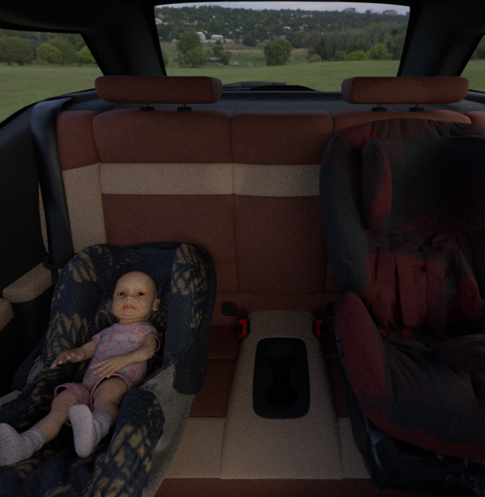
MAIN CHALLENGE
The goal of the main challenge was to create an AI solution for identifying child seats in the passenger vehicle.

Slide 3
methodology
Identifying the passenger vehicle
Localizing the passenger vehicle is important to avoid identifying child seats that are not inside the car.
IDENTIFYING CHILD SEATS
The problem states that it is necessary to localize child seats, so identifying infant seats as well is not in the scope of this challenge.
CHECKING IF THE CHILD SEATS ARE INSIDE THE PASSENGER VEHICLE
The final step is checking if the area of the child seat that was found in the picture is inside the area of the passenger vehicle.

Slide 4
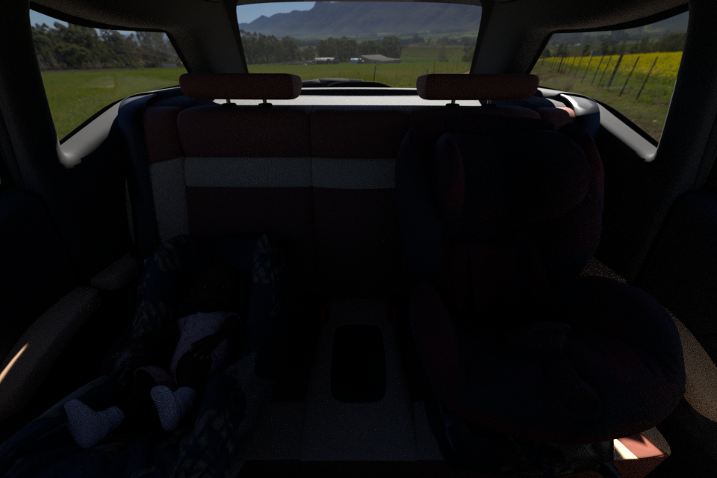
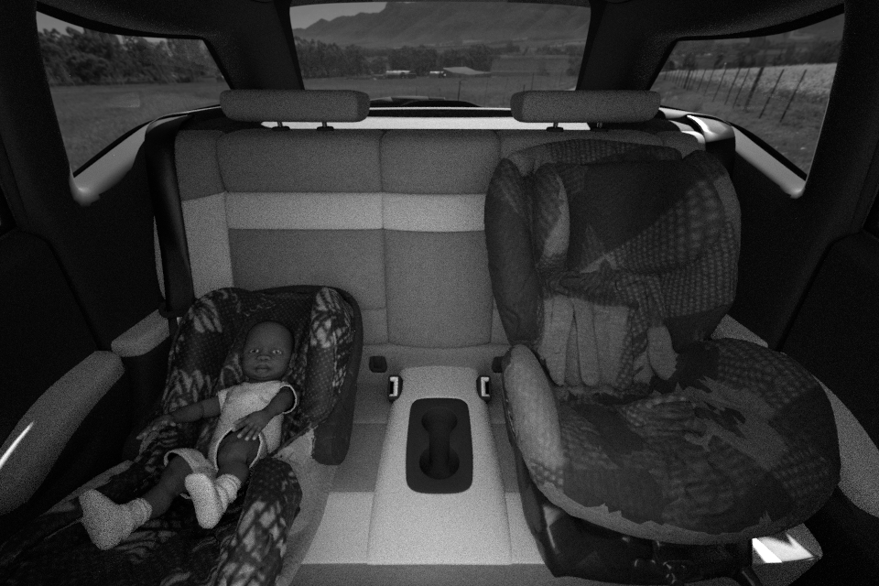
Dataset construction
ABOUT the Dataset
It was used images containing infant seats and child seats inside a passenger vehicle from SVIRO dataset (https://sviro.kl.dfki.de/)
IMAGES CHOSEN
Picture 1: RGB
It was chosen to only use grayscale images, as in the RGB mode it is present the occlusion problem due to low light. 10 different car classes were used.
Number of images used
It was used 50 images for each car class, totalizing 500 images, which contains at least 1 child seat inside the passenger Vehicle.
Picture 2: Grayscale (simulating infrared)

Slide 5
Dataset construction
500 images = total
300 images = train
100 images = test
100 images = validation
Mercedes - Aclass
Ford - Escape
Toyota - Hilux
BMW I3
Lexus – GS F
Tesla – model 3
VW - Tiguan
Hyundai - Tucson
BMW - X5
BMW - X5
Renault - Zoe

Slide 6
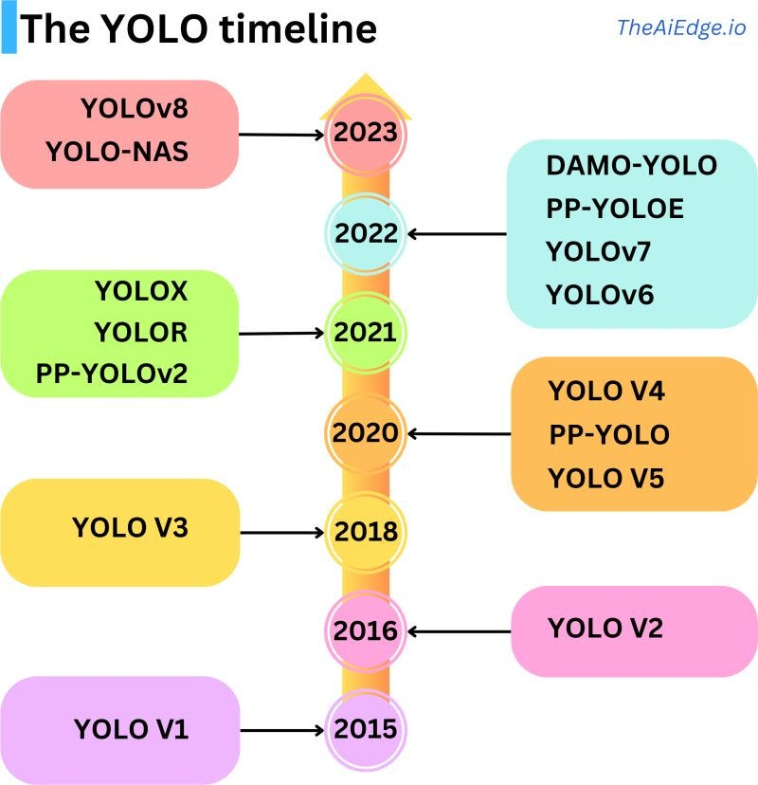
Algorithm: Yolo v7
(https://github.com/WongKinYiu/yolov)
According to Data Phoenix, YOLOv7 is currently the version considered the fastest and most accurate real-time object detector, even with the release of YOLOv8.
Its architecture is based on deep learning, and automatically handles the generation of synthetic data.
The model was fine-tuned using the fastest weights for detection “YOLOv7.pt”, due to limited development time, with only 100 epochs inside google colab platform.

Slide 7
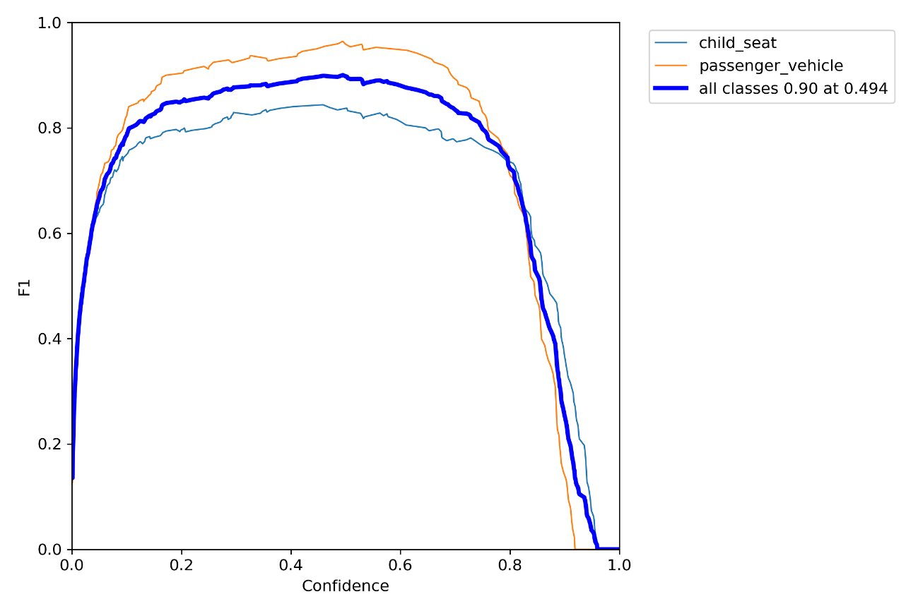
results
The F-measure is the weighted harmonic mean of precision (P) and recall (R) of a classifier.
The best F1 score occurred when the confidence interval was at 0.494.

Slide 8
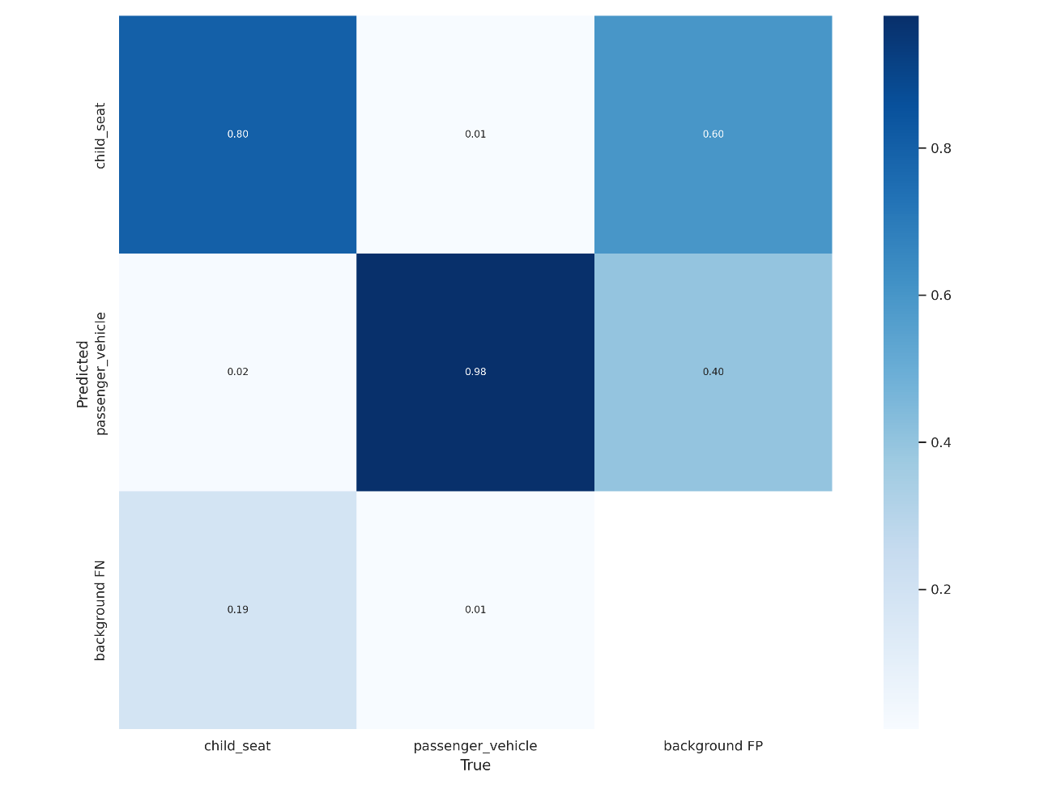
results

Slide 9
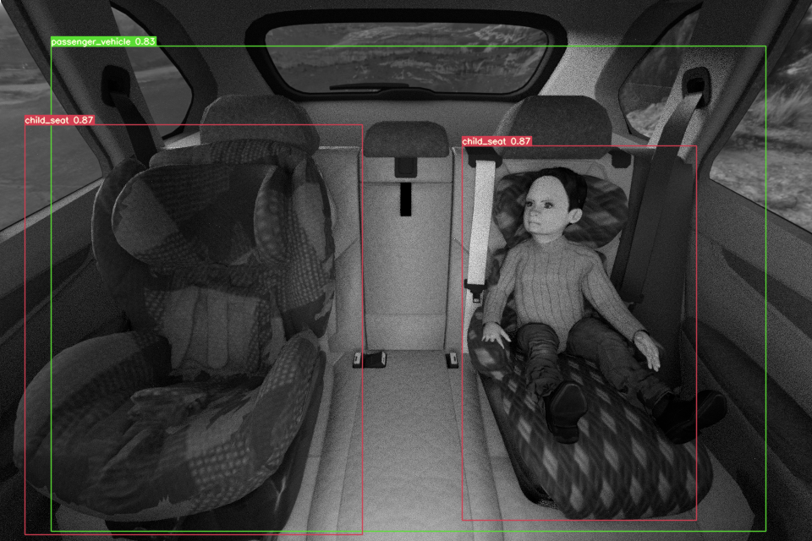
Results
Correct prediction with high confidence.

Slide 10
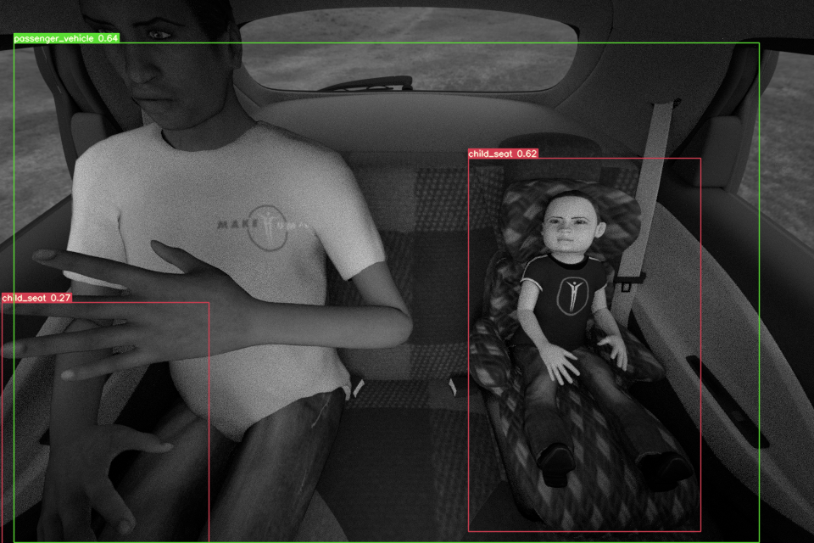
results
Incorrect prediction with low confidence.

Slide 11
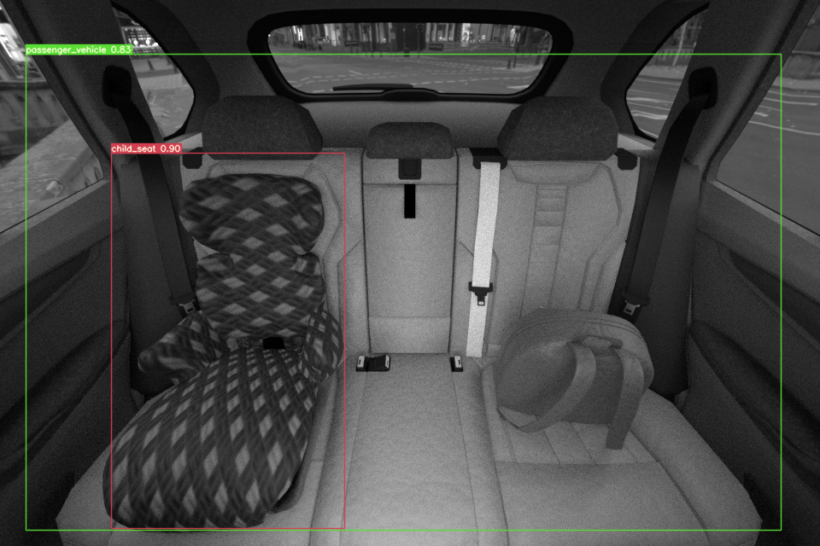
results
The final step of this challenge calculates the percentage of the area of the child seat that stands inside the passenger vehicle, returning if the child seat is indeed inside the passenger vehicle.

Slide 12
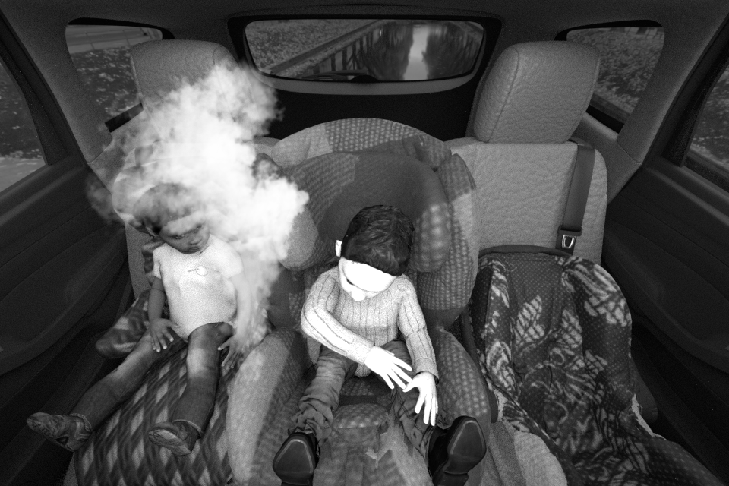
bonus CHALLENGE
The goal of this bonus challenge was to generate synthetic data by inserting smoke inside the vehicle, and then implementing a smoke detection system based in an AI algorithm.

Slide 13
methodology
Downloading smoke pictures
The smoke images downloaded had no background, because they are easier to combine to another picture (which in this case was the interior of the vehicle).
Transforming to grayscale
The images from the vehicles are the same used in the main challenge, which means that they are grayscale, so, in order to create a more fluid mix, the smoke pictures were transformed as well
Generating data augmentation
With the aid of the AugLy library, it was generated some synthetic data with smoke inside the interior of the vehicle

Slide 14
Dataset construction
32 different smoke images
Synthetic images generation
500 images = total
300 images = train
100 images = test
100 images = validation

Slide 15
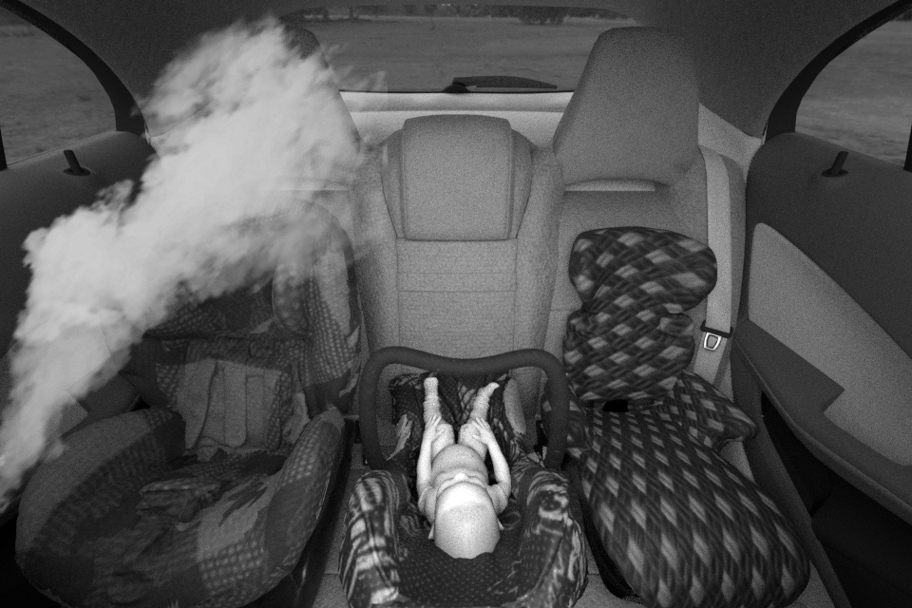

Dataset Example synthetic images generation

Slide 16
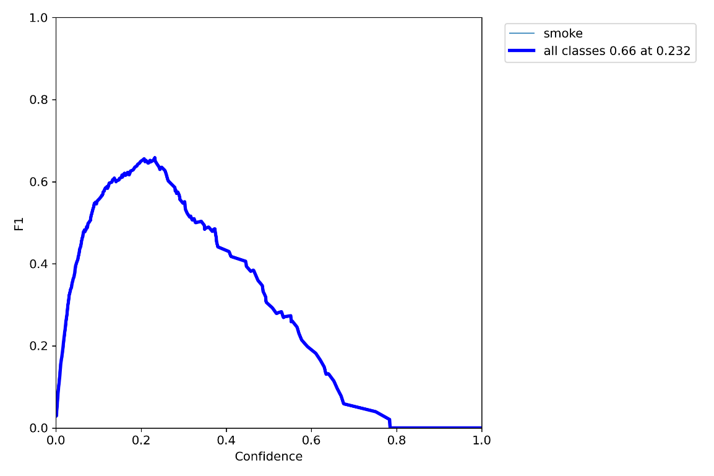
results
It was used the same architecture of the main challenge (YOLOv7), with the same hyperparams

Slide 17
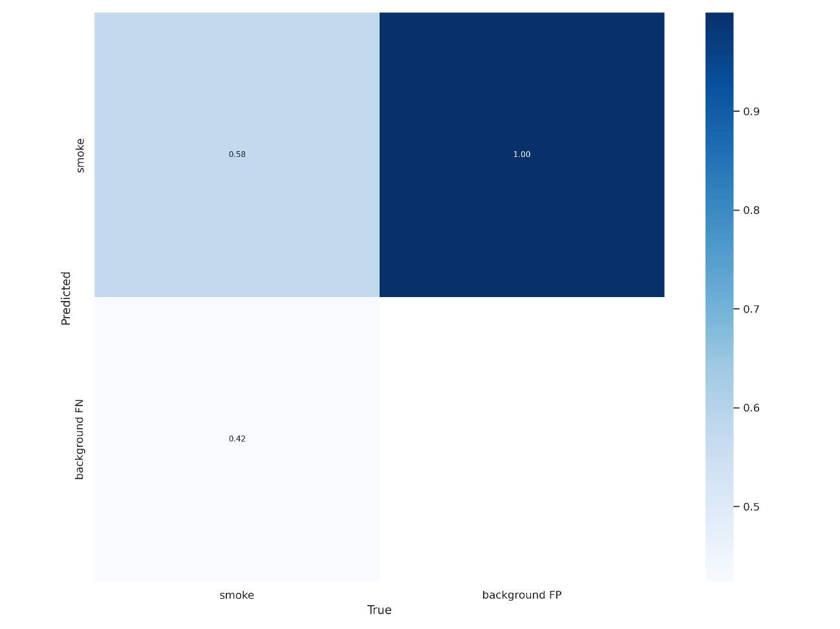
results

Slide 18
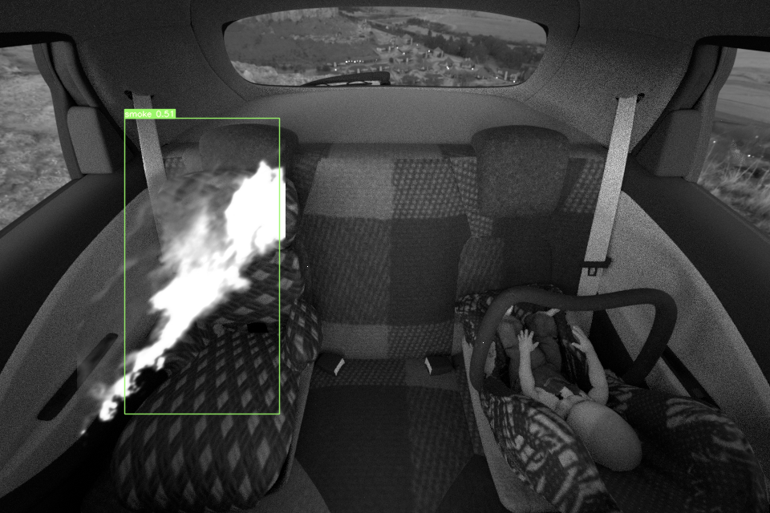
Results
Correct prediction with not so high confidence.

Slide 19
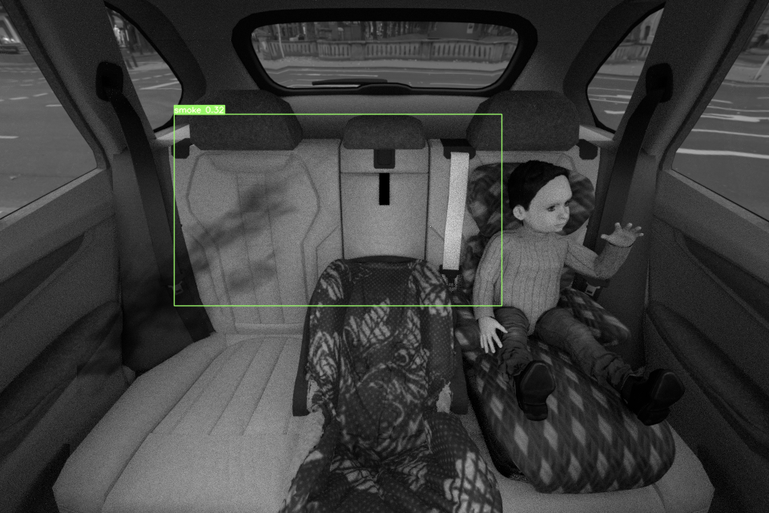
Results
Incorrect prediction with low confidence.

Slide 20
conclusions
Both of the trained models has shown to learn on how to identify their tasks, and there is still room for some enhancements, specially in the smoke detection system.
The next steps for these refinements could be described as:
Grabbing more pictures (png smoke images for the bonus challenge and adding more angles of the pictures inside the car), which makes the algorithm more robust, as deep learning model-based algorithms tends to learn better when there are large pools of data.
Implementing even more data augmentation techniques, including generating some pictures with generative AI.
Training with different parameters, such as the learning rate, epochs, batch size, etc.
Training more accurate models, like the YOLOv7-E6E instead of the fastest YOLO version.

Slide 21
Thank you
Bosch tech challenge
Rodolfo Viturino
rodolfo.viturino@hotmail.com​
https://github.com/rodolfoviturino

